Slide 1
HOTEL ROOM MANAGEMENT SYSTEM
2103A51301 : Krishna Sai
2103A51336 : Deepthi
2103A51306 : Sai Prasad
2103A51304 : Sahith
Under the guidance
of
K . Ravi Chytanya

Slide 2
Abstract
This Project aims at creating an Hotel Reservation that can be used by customers to reserve hotel rooms. Users can view rooms and facilities. Users can register by giving minimum information and reserve a room. The administrator will know the details of daily reservation done by users. Purpose of making such application is to make people’s work quicker and save time of users and save paper work.

Slide 3
Existing Systems
In this existing system the user needs to create an account to reserve a room. Different types of rooms are listed in one page. Facilities provided are mentioned in separate page. Mandatory details are to be given to book a room. 3 types of rooms are available to book. Each room details and facilities are provided in separate pages. Online payment is present by using cards only. Availability of the rooms are mentioned in booking page.

Slide 4
Drawbacks:
Delay to Internet connection for cloud based software.
High Risk to cyber-attack.
If some one want to book a room they need compulsory create an account.
There is no surety of availability of rooms.
Less secure webservice.
If someone already booked a room and if he want to cancel the room there is no refund option.
No Hotel Customer Service provided.

Slide 5
System we are providing :
In our system we provide a home page which is a title page for hotel. Total 6 pages are designed for different sections in this system. Explore page consists of overall facilities provided by the hotel. All available types of rooms are described in one page. To reserve a room customer need to provide minimum information. Login page is provided for receptionist to see reservations of rooms. Feedback page is provided to the customer after reservation

Slide 6
Advantages
Reducing the cyber-attack.
There is a surety of availability of rooms whether the room is booked or not.
If someone want to book a room he/she need give minimum information.
Reservation time is reduced.
Security to personal information.
No online payments through website is provided.
Anytime reservation without payment.

Slide 7
Stakeholders
1.Primary stakeholders:
Customers
Receptionist
2.Secondary stakeholders:
Manager
3.Tertiary stakeholders:
Hotel owners
Investors
4.Facilitating stakeholders:
People who are involved in design and development of the system

Slide 8
Architectural design

Slide 9
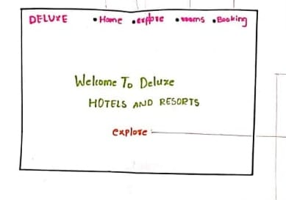
Home page:

Slide 10
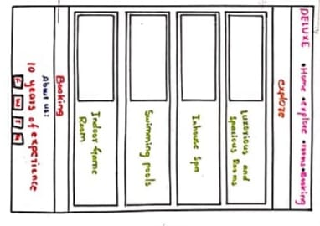
Explore page:

Slide 11
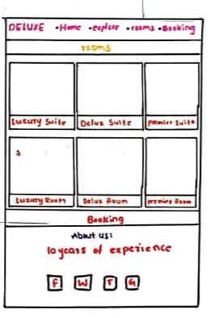
Rooms page:

Slide 12
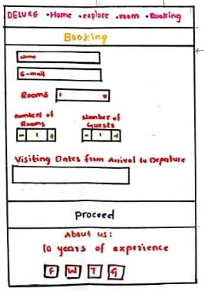
Booking page:

Slide 13
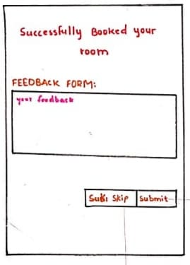
Feedback page:

Slide 14
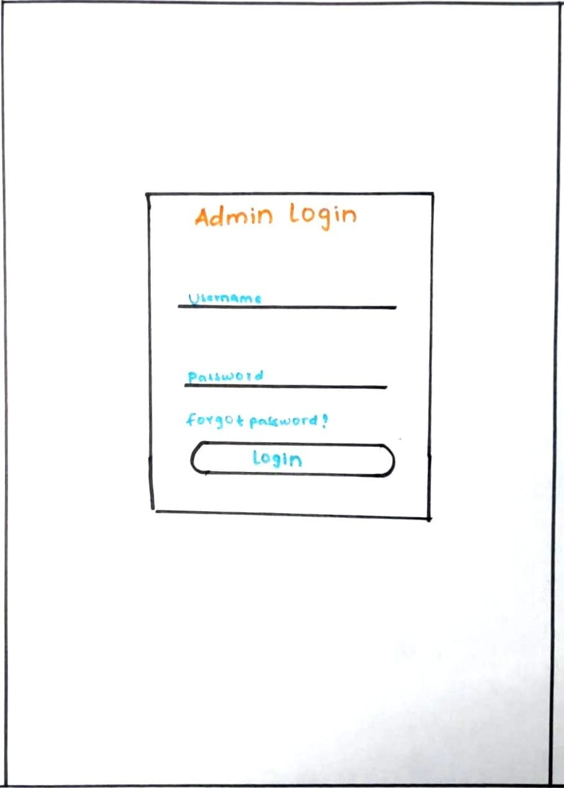
Admin login page:

Slide 15
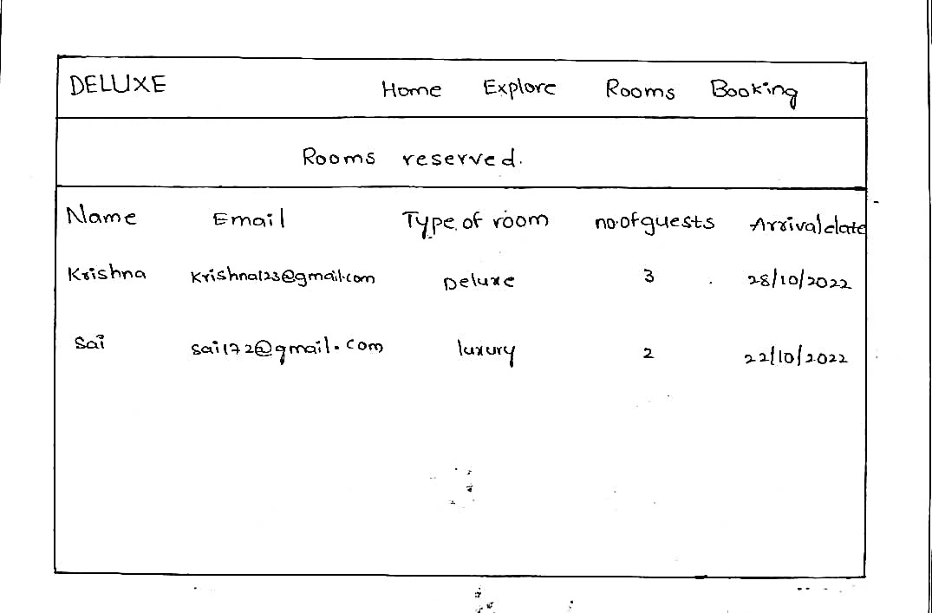
Reservation details page: (Admin side)

Slide 16
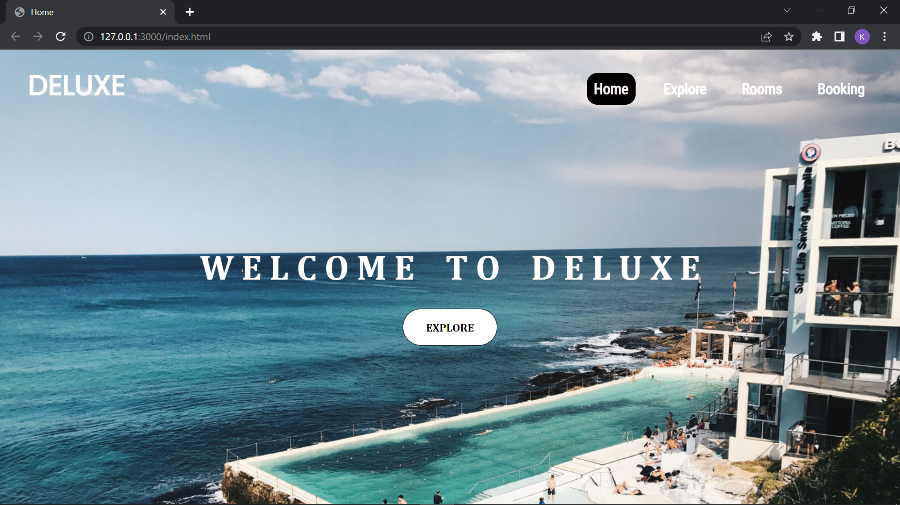
Home page:

Slide 17
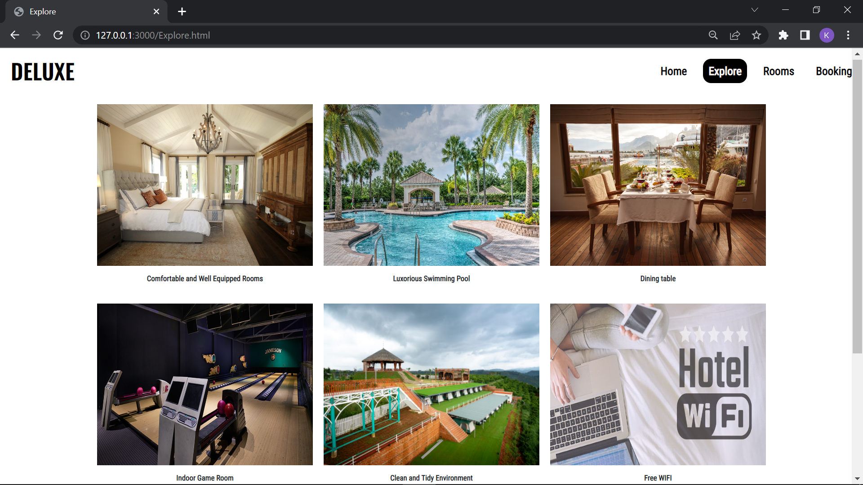
Explore page:

Slide 18
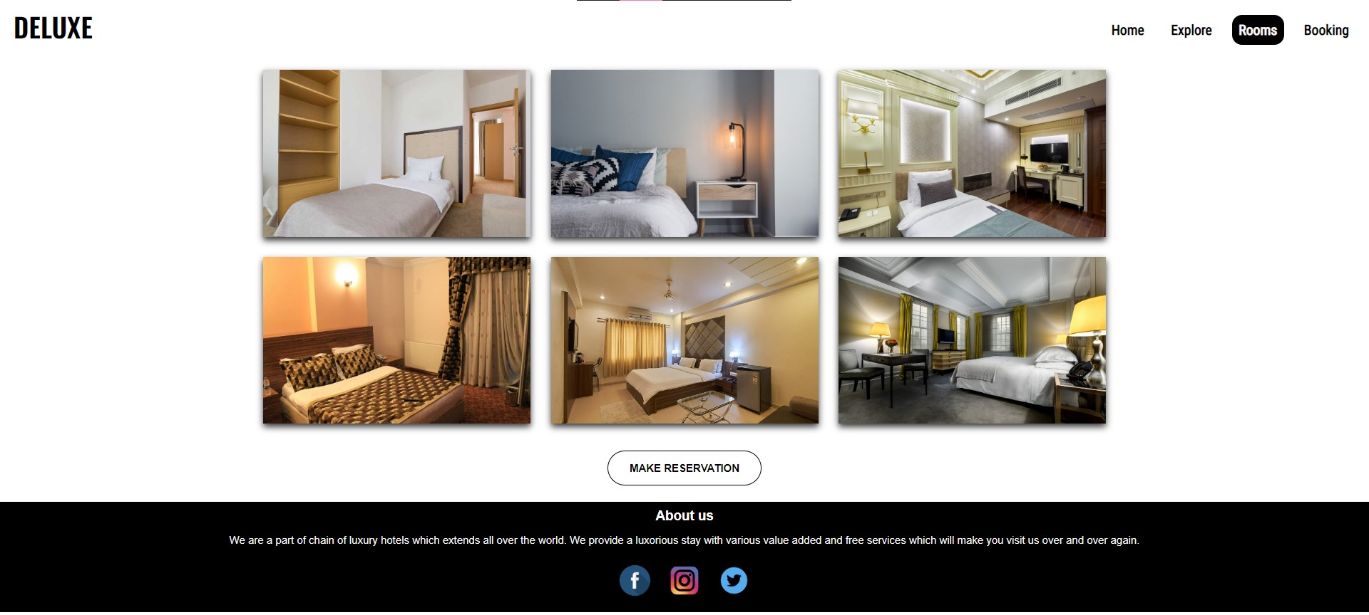
Rooms page:

Slide 19
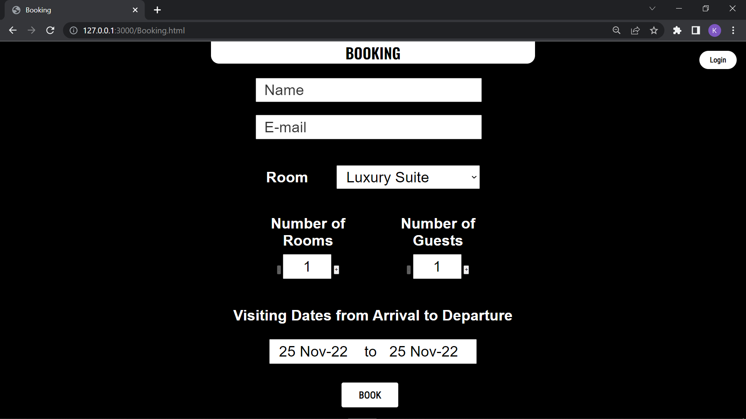
Booking page:

Slide 20
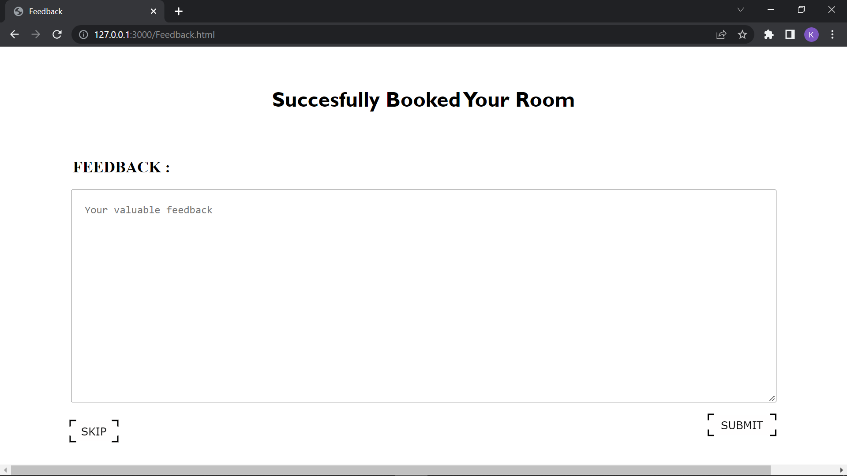
Feedback page:

Slide 21
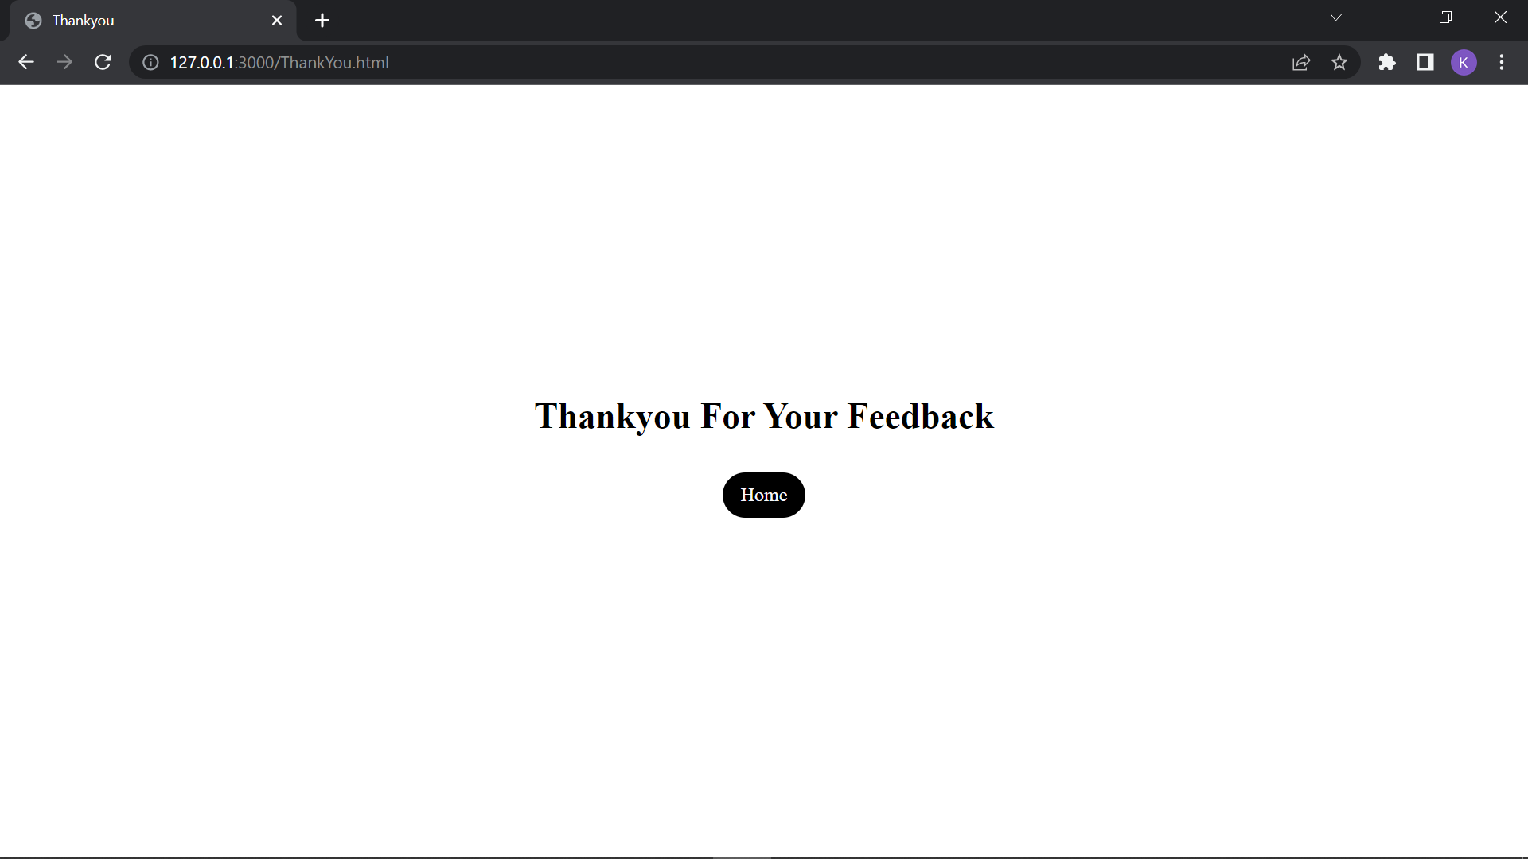
Conclude page:

Slide 22
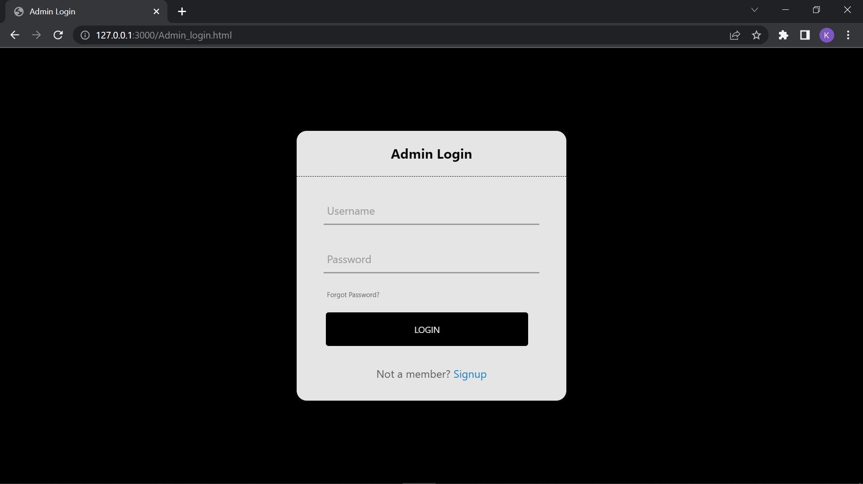
Admin page:

Slide 23
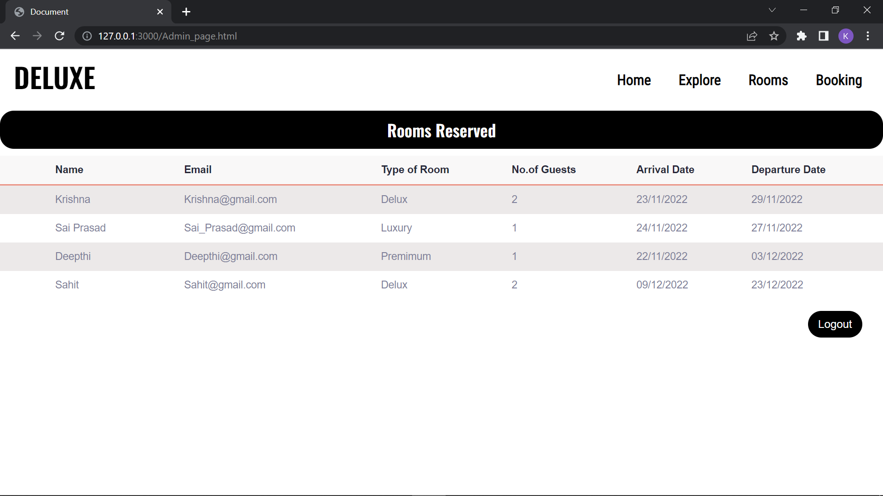
Reservation details page: (Admin side)

Slide 24
| Thank You |

